Slide 1

Microprocessors
A microprocessor is a CPU on a single chip.
If a microprocessor, its associated support circuitry, memory and peripheral I/O components are implemented on a single chip, it is a microcontroller.
  We use AVR microcontroller as the example in our course study

Slide 2
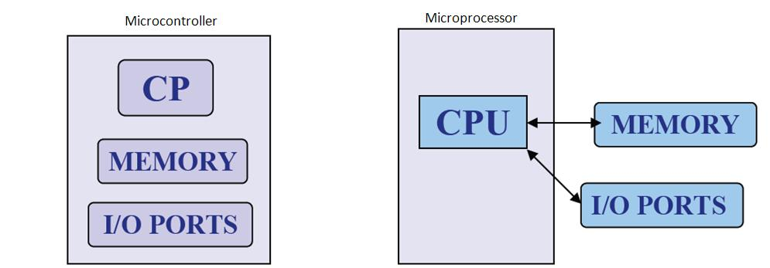
What is Microprocessor and Microcontroller?

Slide 3
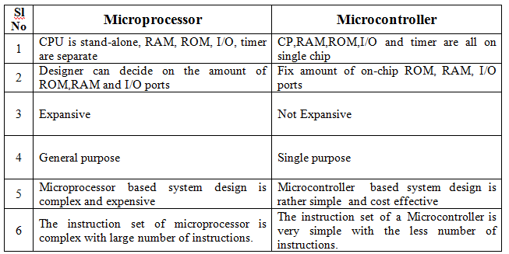

Slide 4
Internal structure and basic operation of microprocessor
ALU
Register Section
Address bus
Data bus
Control and timing section
Control bus
Block diagram of a Microprocessor

Slide 5

Microprocessor types
Microprocessors can be characterized based on
  the word size
    8 bit, 16 bit, 32 bit, etc. processors
  Instruction set structure
    RISC (Reduced Instruction Set Computer), CISC (Complex Instruction Set Computer)
  Functions
    General purpose, special purpose such image processing, floating point calculations
  And more …
Week3

Slide 6
Typical microprocessors
Most commonly used
  68K
    Motorola
  x86
    Intel
  IA-64
    Intel
  MIPS
    Microprocessor without interlocked pipeline stages
  ARM
    Advanced RISC Machine
  PowerPC
    Apple-IBM-Motorola alliance
  Atmel AVR
A brief summary will be given later
Week3

Slide 7
Introduction to 8086 Assembly Language
Assembly Language Programming

Slide 8
Program Statements
Program consist of statement, one per line.
Each statement is either an instruction, which the assembler translate into machine code, or assembler directive, which instructs the assembler to perform some spesific task, such as allocating memory space for a variable or creating a procedure.
Both instructions and directives have up to four fields:
At least one blank or tab character must separate the fields
name operation operand(s) comment

Slide 9
Program Statements
An example of an instruction is
START: MOV CX,5 ; initialize counter
  The name field consists of the label START:
  The operation is MOV, the operands are CX and 5
  And the comment is ; initialize counter
name operation operand(s) comment
An example of an assembler directive is
MAIN PROC
  MAIN is the name, and the operation field contains PROC
  This particular directive creates a procedure called MAIN
name operation operand(s) comment

Slide 10
Program Statements
name operation operand(s) comment
A Name field identifies a label, variable, or symbol.
It may contain any of the following character : A,B…..Z ; a,b….z ; 0,1….9 ; ? ;
_ (underline) ; @ ; $ ; . (period)
Only the first 31 characters are recognized
There is no distinction between uppercase and lower case letters.
The first character may not be a digit
If it is used, the period ( . ) may be used only as the first character.
A programmer-chosen name may not be the same as an assembler reserved word.

Slide 11

Program Statements
name operation operand(s) comment
Operation field is a predefined or reserved word
  mnemonic - symbolic operation code.
    The assembler translates a symbolic opcode into a machine language opcode.
    Opcode symbols often discribe the operation’s function; for example, MOV, ADD, SUB
  assemler directive - pseudo-operation code.
    In an assembler directive, the operation field contains a pseudo-operation code (pseudo-op)
    Pseudo-op are not translated into machine code; for example the PROC pseudo-op is used to create a procedure

Slide 12
Program Statements
name operation operand(s) comment
An operand field specifies the data that are to be acted on by the operation.
An instruction may have zero, one, or two operands. For example:
    NOP No operands; does nothing
    INC AX one operand; adds 1 to the
    contents of AX
    ADD WORD1,2 two operands; adds 2 to the contents of memory word WORD1

Slide 13
Program Statements
name operation operand(s) comment
The comment field is used by the programmer to say something about what the statement does.
A semicolon marks the beginning of this field, and the assembler ignores anything typed after semicolon.
Comments are optional, but because assembly language is low level, it is almost impossible to understand an assembly language program without comments.

Slide 14
Program Data and Storage
Pseudo-ops to define data or reserve storage
  DB - byte(s)
  DW - word(s)
  DD - doubleword(s)
  DQ - quadword(s)
  DT - tenbyte(s)
These directives require one or more operands
  define memory contents
  specify amount of storage to reserve for run-time data

Slide 15
Defining Data
Numeric data values
  100 - decimal
  100B - binary
  100H - hexadecimal
  '100' - ASCII
  "100" - ASCII
Use the appropriate DEFINE directive (byte, word, etc.)
A list of values may be used - the following creates 4 consecutive words
  DW 40CH,10B,-13,0
A ? represents an uninitialized storage location
  DB 255,?,-128,'X'

Slide 16
Naming Storage Locations
Names can be associated with storage locations
  ANum DB -4
  DW 17
  ONE
  UNO DW 1
  X DD ?
These names are called variables
ANum refers to a byte storage location, initialized to FCh
The next word has no associated name
ONE and UNO refer to the same word
X is an unitialized doubleword

Slide 17
• Multiple definitions can be abbreviated
Example:
message DB ’B’
DB ’y’
DB ’e’
DB 0DH
DB 0AH
can be written as
message DB ’B’,’y’,’e’,0DH,0AH
• More compactly as
message DB ’Bye’,0DH,0AH

Slide 18
Arrays
Any consecutive storage locations of the same size can be called an array
  X DW 40CH,10B,-13,0
  Y DB 'This is an array'
  Z DD -109236, FFFFFFFFH, -1, 100B
Components of X are at X, X+2, X+4, X+6
Components of Y are at Y, Y+1, …, Y+15
Components of Z are at Z, Z+4, Z+8, Z+12

Slide 19
DUP
Allows a sequence of storage locations to be defined or reserved
Only used as an operand of a define directive
DB 40 DUP (?) ; 40 words, uninitialized
DW 10h DUP (0) ; 16 words, initialized as 0
Table1 DW 10 DUP (?) ; 10 words, uninitialized
message DB 3 DUP (’Baby’) ; 12 bytes, initialized
; as BabyBabyBaby
Name1 DB 30 DUP (’?’) ; 30 bytes, each
; initialized to ?

Slide 20
DUP
The DUP directive may also be nested
Example
stars DB 4 DUP(3 DUP (’*’),2 DUP (’?’),5 DUP (’!’))
Reserves 40-bytes space and initializes it as
***??!!!!!***??!!!!!***??!!!!!***??!!!!!
matrix DW 10 DUP (5 DUP (0))
defines a 10X5 matrix and initializes its elements to zero.
This declaration can also be done by
matrix DW 50 DUP (0)

Slide 21
Word Storage
Word, doubleword, and quadword data are stored in reverse byte order (in memory)
Directive Bytes in Storage
DW 256 00 01
DD 1234567H 67 45 23 01
DQ 10 0A 00 00 00 00 00 00 00
X DW 35DAh DA 35
  Low byte of X is at X, high byte of X is at X+1

Slide 22
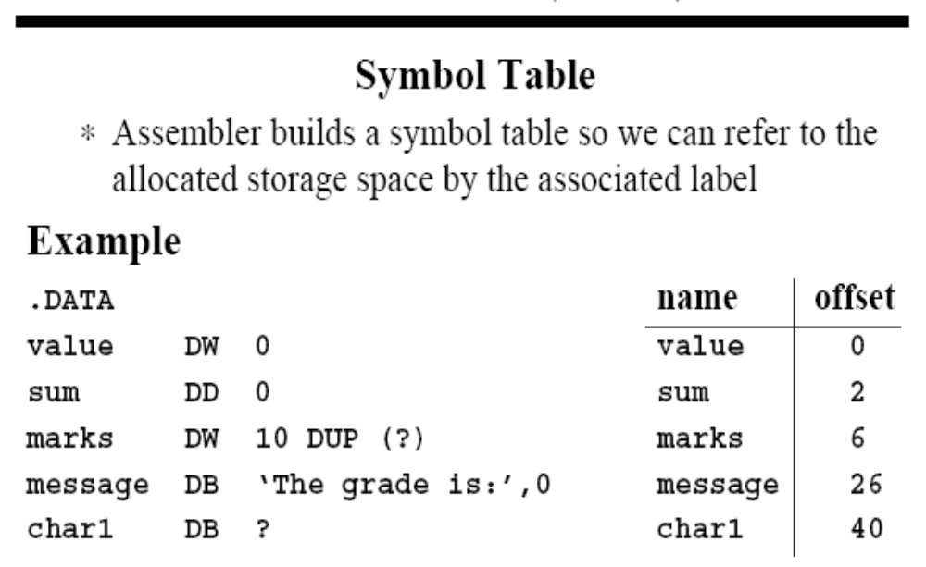
Word Storage

Slide 23
Named Constants
Symbolic names associated with storage locations represent addresses
Named constants are symbols created to represent specific values determined by an expression
Named constants can be numeric or string
Some named constants can be redefined
No storage is allocated for these values

Slide 24
Equal Sign Directive
name = expression
  expression must be numeric
  these symbols may be redefined at any time
  maxint = 7FFFh
  count = 1
  DW count
  count = count * 2
  DW count

Slide 25
EQU Directive
name EQU expression
  expression can be string or numeric
  Use < and > to specify a string EQU
  these symbols cannot be redefined later in the program
  sample EQU 7Fh
  aString EQU <1.234>
  message EQU <This is a message>

Slide 26
Data Transfer Instructions
MOV target, source
  reg, reg
  mem, reg
  reg, mem
  mem, immed
  reg, immed
Sizes of both operands must be the same
reg can be any non-segment register except IP cannot be the target register
MOV's between a segment register and memory or a 16-bit register are possible

Slide 27
Sample MOV Instructions
b db 4Fh
w dw 2048
mov bl,dh
mov ax,w
mov ch,b
mov al,255
mov w,-100
mov b,0
When a variable is created with a define directive, it is assigned a default size attribute (byte, word, etc)
You can assign a size attribute using LABEL
  LoByte LABEL BYTE
  aWord DW 97F2h

Slide 28
Program Segment Structure
Data Segments
  Storage for variables
  Variable addresses are computed as offsets from start of this segment
Code Segment
  contains executable instructions
Stack Segment
  used to set aside storage for the stack
  Stack addresses are computed as offsets into this segment
Segment directives
  .data
  .code
  .stack size

Slide 29
Instruction types
Data transfer instructions
8086 instruction set
IN Input byte or word from port
LAHF Load AH from flags
LDS Load pointer using data segment
LEA Load effective address
LES Load pointer using extra segment
MOV Move to/from register/memory
OUT Output byte or word to port
POP Pop word off stack
POPF Pop flags off stack
PUSH Push word onto stack
PUSHF Push flags onto stack
SAHF Store AH into flags
XCHG Exchange byte or word
XLAT Translate byte
Additional 80386 instructions
LFS Load pointer using FS
LGS Load pointer using GS
LSS Load pointer using SS
MOVSX Move with sign extended
MOVZX Move with zero extended
POPAD Pop all double (32 bit) registers
POPD Pop double register
POPFD Pop double flag register
PUSHAD Push all double registers
PUSHD Push double register
PUSHFD Push double flag register
Additional 80486 instruction
BSWAP Byte swap
Additional 80286 instructions
INS Input string from port
OUTS Output string to port
POPA Pop all registers
PUSHA Push all registers
Additional Pentium instruction
MOV Move to/from control register

Slide 30
Arithmetic instructions
8086 instruction set
AAA ASCII adjust for addition
AAD ASCII adjust for division
AAM ASCII adjust for multiply
AAS ASCII adjust for subtraction
ADC Add byte or word plus carry
ADD Add byte or word
CBW Convert byte or word
CMP Compare byte or word
CWD Convert word to double-word
DAA Decimal adjust for addition
DAS Decimal adjust for subtraction
DEC Decrement byte or word by one
DIV Divide byte or word
IDIV Integer divide byte or word
IMUL Integer multiply byte or word
INC Increment byte or word by one
MUL Multiply byte or word (unsigned)
NEG Negate byte or word
SBB Subtract byte or word and carry (borrow)
SUB Subtract byte or word
Additional 80386 instructions
CDQ Convert double-word to quad-word
CWDE Convert word to double-word
Additional 80486 instructions
CMPXCHG Compare and exchange
XADD Exchange and add
Additional Pentium instruction
CMPXCHG8B Compare and exchange 8 bytes

Slide 31
Bit manipulation instructions
8086 instruction set
AND Logical AND of byte or word
NOT Logical NOT of byte or word
OR Logical OR of byte or word
RCL Rotate left trough carry byte or word
RCR Rotate right trough carry byte or word
ROL Rotate left byte or word
ROR Rotate right byte or word
SAL Arithmetic shift left byte or word
SAR Arithmetic shift right byte or word
SHL Logical shift left byte or word
SHR Logical shift right byte or word
TEST Test byte or word
XOR Logical exclusive-OR of byte or word
Additional 80386 instructions
BSF Bit scan forward
BSR Bit scan reverse
BT Bit test
BTC Bit test and complement
BTR Bit test and reset
BTS Bit test and set
SETcc Set byte on condition
SHLD Shift left double precision
SHRD Shift right double precision

Slide 32
String instructions
8086 instruction set
CMPS Compare byte or word string
LODS Load byte or word string
MOVS Move byte or word string
MOVSB(MOVSW) Move byte string (word string)
REP Repeat
REPE (REPZ) Repeat while equal (zero)
REPNE (REPNZ) Repeat while not equal (not zero)
SCAS Scan byte or word string
STOS Store byte or word string

Slide 33
Program Skeleton
.model small
.stack 100H
.data
;declarations
.code
main proc
;code
main endp
;other procs
end main
Select a memory model
Define the stack size
Declare variables
Write code
  organize into procedures
Mark the end of the source file
  optionally, define the entry point

Slide 34
EXAMPLE : Adding two 8 bit numbers
DATA SEGMENT ; Data Segment
N1 DB 12H
N2 DB 21H
RES DB ?
DATA ENDS
CODE SEGMENT ; Code segment
ASSUME CS: CODE, DS: DATA
START: MOV AX, DATA
MOV DS, AX
MOV AL, N1
MOV BL, N2
ADD AL, BL
MOV RES, AL
INT 21H
CODE ENDS
END START

